Slide 1
The Trade: Paul vs. Westbrook
NBA DATA ANALYSTS:
'Sanjay Suresh', 'Mitsuko Kitazawa', 'Nicolas Gomez Bustamante', 'Nicholas Keller'

Slide 2
Agenda
About the Trade project
Data source & Analysis approach
Results
Conclusions

Slide 3


About the Trade project
Last season’s Rockets point guard was Chris Paul (34 years old)
This off-season Paul was traded to the Thunders for Russel Westbrook (30 years old) – additional draft picks were sent
The objective of our project was to analyze the trade by comparing both players and determine who is the best asset for the team

Slide 4
Data source used & Analysis approach
The statistical analysis used an API from the NBA website: nba_api.stats (no key needed)
Comparative analysis used career stats from Westbrook and Paul, merged them by Season and Age, matplotlib plots were used to support the analysis
Regression XXX

Slide 5
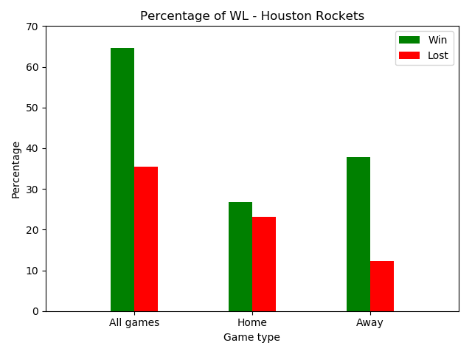
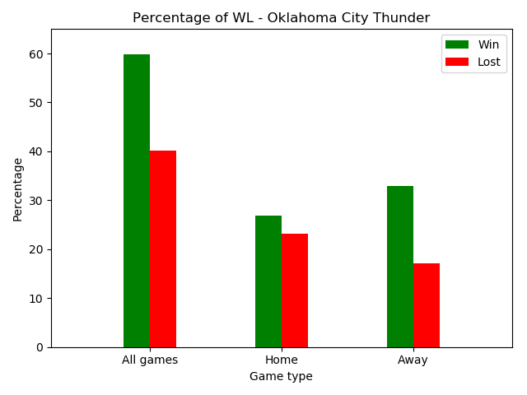
Results Comparative Analysis
- Rockets in general had higher number of wins than Thunders
- Rockets were a better away team

Slide 6
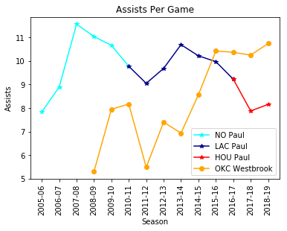
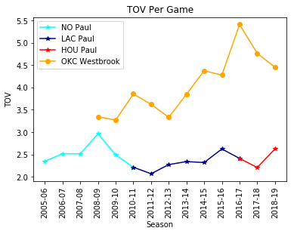
Results Comparative Analysis
- Paul is declining in Assists whereas Westbrook is improving
- Paul protects the ball better than Westbrook (High TOV is bad)

Slide 7
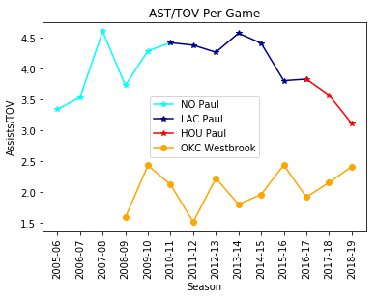
Results Comparative Analysis
- Paul has clearly shown the ability to protect the ball and prevent turn-overs at the point guard position.
- Westbrook has been slowly improving, this is not his strong suit.

Slide 8
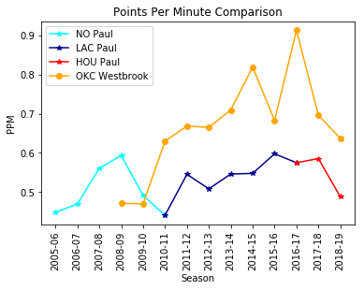
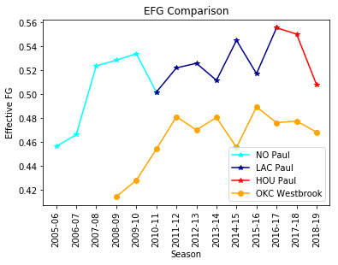
Results Comparative Analysis
- Westbrook is a more prolific scorer
- Paul is a more accurate shooter

Slide 9
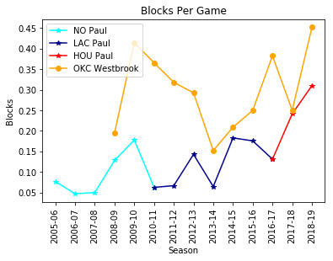
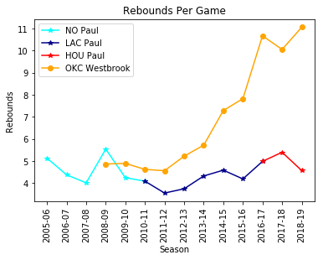
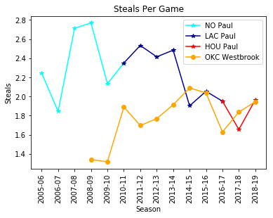
Results
Westbrook outperforms Paul in blocks and rebounds
Paul has been able to accumulate more steals over his career, however they were tied at the age of 30

Slide 10
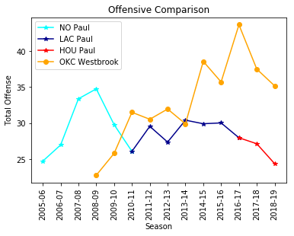
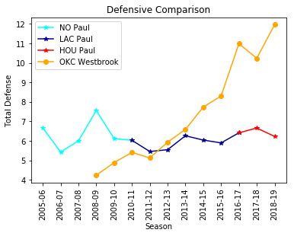
Results Comparative Analysis
Statistically on Offensive and Defensive indicators, Westbrook has surpassed Paul

Slide 11
Results Comparative Analysis

Slide 12
Conclusions
Westbrook is the best fit for the Rockets at this stage of his career based on the data
At this point, he provides the most value based on his statistics on the offense and defensive side of the ball
He is a more accomplished scorer, rebounder, and provides more opportunities to his teammates through assists.
The statistical analysis shows us that an increase in team points correlates with a higher overall plus/minus. Russell can provide this increase and is an upgrade over Paul.

